Slide 1
ToDo
Comparing fuzzing speed and crash detection ability of AFL++ normal mode and that of (manually configured) persistent mode
On programs with known crashes
With address sanitizer or without address sanitizer
Implementing automated global variable reinitialization for AFL++ persistent mode (On-going)
Using LLVM pass that provides analysis APIs for global variables
Developing (ideas for) automated deferred initialization and shared memory test cases

Slide 2
Target Programs
bison-3.7 (fails to apply persistent mode)
cflow-1.6
Building a control-flow graph from a given C source file
Without sanitizer
Persistent mode wrapping main possible with manual reinitialization
Manual deferred initialization before the first argv processing

Slide 3
Manual Reinitialization for cflow
Clear variables in the global region
Clear argument file list
Prevent closing “stdout”

Slide 4
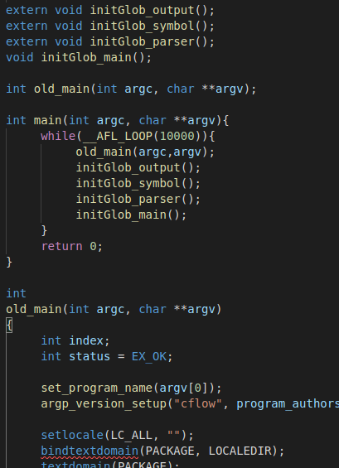
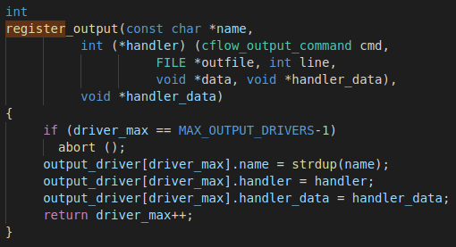
Manual Reinitialization for cflow
Clear variables in the global region
which can cause crash on persistent mode
Reinitialization functions for global variables in different files
Call the reinitialization functions at the end of the main function call
register output driver for each persistent mode iteration, which finally exceeds the MAX_OUTPUT_DRIVERS

Slide 5
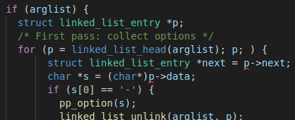
Manual Reinitialization for cflow
Clear argument file list
which stores the input files of previous runs unexpectedly
which does not cause crash but significantly increase execution time
arglist have input files of previous runs thus, program processes all the input files of previous runs

Slide 6
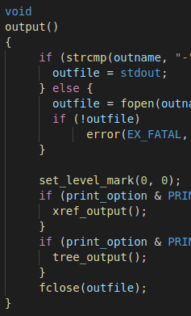
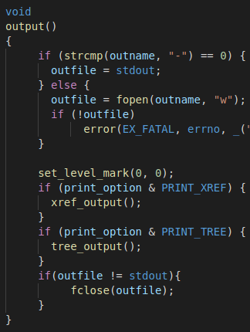
Manual Reinitialization for cflow
Prevent closing “stdout”
which does not cause crash
but, affects the program state outside the program memory space (e.g., file system)
Close outfile whether it is stdout or not thus, next run cannot use stdout

Slide 7
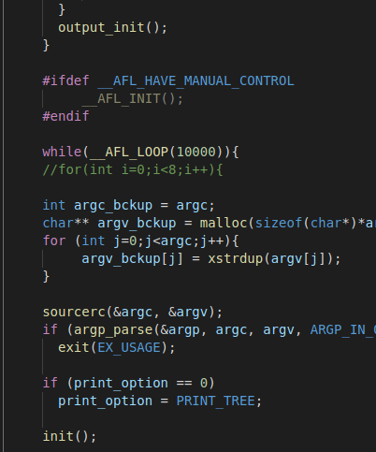
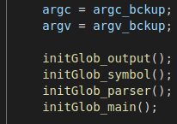
Manual Deferred Initialization
Initialize the target program instance just before the first argv processing
In the main function
Deferred initialization
Starting persistent mode loop after the deferred initialization
Manual state backup
(backup argc and argv because cflow modify argc and argv)
First argv processing point
…
Manual state reset at the end of the persistent loop

Slide 8
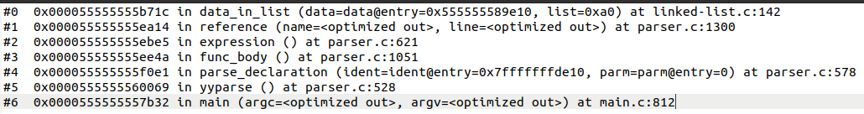
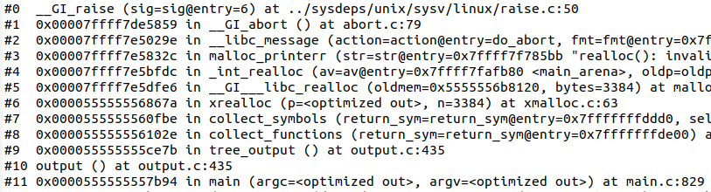
Results
Speed-up when using PM but, worse crash detection ability
cflow-1.6 | exec/sec | bitmap_cvg | stability | saved crashes (reproducible)
Normal | 2437.59 | 21.58% | 100.00% | 189
PM | 10985.00 | 22.54% | 21.94% | 207 (199)
DI | 2946.05 | 22.14% | 100.00% | 217
DI+PM | 12335.84 | 21.55% | 21.23% | 181 (138)
188 known crashes and 1 new crash
All the known crashes
215 known crashes and 2 new crashes
All the known crashes
An example stack trace of the known crash
Too low stability which causes not-reproducible crash inputs
Need more exhaustive reinitialization?
Stack trace of the new crash

Slide 9

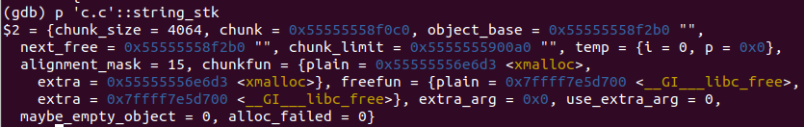
Exhaustive Reinitialization
Reinitialize all global variables that are changed after a run
Make a list of
Global Variables (GV)
GV list
For each GV in the list
Run gdb
Target program
A seed input
Extract the value
of the GV at the beginning
Extract the value
of the GV at the end
GV value
at the beginning
GV value
at the end
If they are different,
GV list to reinitialize
GV
‘c.c’::string_stk at the beginning
‘c.c’::string_stk at the end

Slide 10
Results with Exhaustive Reinit.
Slightly increased stability, but significant slow down and worse crash detection ability
cflow-1.6 | exec/sec | bitmap_cvg | stability | saved crashes (reproducible)
Normal | 2437.59 | 21.58% | 100.00% | 189
PM | 10985.00 | 22.54% | 21.94% | 207 (199)
PM (ExReinit) | 3703.74 | 22.55% | 31.79% | 183 (179)
188 known crashes and 1 new crash
All the known crashes
All the known crashes

Slide 11
Result Summary of the Four Target Programs
cflow-1.6 | exec/sec | bitmap_cvg | stability | saved crashes
Normal | 2437.59 | 21.58% | 100.00% | 189
PM | 10985.00 | 22.54% | 21.94% | 207 (199)
DI | 2946.05 | 22.14% | 100.00% | 217
DI+PM | 12335.84 | 21.55% | 21.23% | 181 (138)
Two distinguished crashes
Same crashes
Two distinguished crashes
Same crashes
binutils2.36.1/nm | exec/sec | bitmap_cvg | stability | saved crashes
Normal | 480.43 | 3.80% | 100.00% | 0
PM | 461.51 | 3.81% | 100.00% | 0
binutils2.36.1/size | exec/sec | bitmap_cvg | stability | saved crashes
Normal | 417.38 | 2.95% | 100.00% | 7
PM | 991.31 | 3.14% | 99.49% | 10
Same crashes
(none of them is the known one)
Three distinguished crashes
(none of them is the known one)
exiv2 0.27.2 | exec/sec | bitmap_cvg | stability | saved crashes
Normal | 2619 | 7.92% | 100.00% | 0
PM | 8545 | 8.22% | 99.20% | 0

Slide 12
Next ToDo
Comparing fuzzing speed and crash detection ability of AFL++ normal mode and that of (manually configured) persistent mode
On programs with known crashes
With address sanitizer or without address sanitizer
Implementing automated global variable reinitialization for AFL++ persistent mode (On-going)
Using LLVM pass that provides analysis APIs for global variables
Developing (ideas for) automated deferred initialization and shared memory test cases

